Slide 1
BANKRUPTCY PREVENTION
Done By :
Sachin Sampath
Kavana V
Manu R
Vijay Balnath Rawal
Dr.Pritee Bharat Naikwade
Kiran Kumar
Rishikesh

Slide 2
TABLE OF CONTENTS
01.
02.
03.
Introduction
Dataset
EDA
04.
05.
06.
Model Building
Deployment
Results

Slide 3
What is a bankruptcy ??
Bankruptcy is a legal process that individuals or businesses go through when they are unable to repay their debts.
Preventing bankruptcy involves proactive financial management and making strategic decisions to maintain solvency.

Slide 4
INTRODUCTION
01
This is a classification project, since the variable to predict is binary (bankruptcy or non-bankruptcy).
The goal here is to model the probability that a business goes bankrupt from different features.

Slide 5
DATASET
02
A data set is a collection of data. In the case of tabular data, a data set corresponds to one or more database tables, where every column of a table represents a particular variable, and each row corresponds to a given record of the data set in question.
The data file contains 7 features about 250 companies

Slide 6
Data Set
The data set includes the following variables:
industrial_risk: 0=low risk, 0.5=medium risk, 1=high risk.
management_risk: 0=low risk, 0.5=medium risk, 1=high risk.
financial flexibility: 0=low flexibility, 0.5=medium flexibility, 1=high flexibility.
credibility: 0=low credibility, 0.5=medium credibility, 1=high credibility.
competitiveness: 0=low competitiveness, 0.5=medium competitiveness, 1=high competitiveness.
operating_risk: 0=low risk, 0.5=medium risk, 1=high risk.
class: bankruptcy, non-bankruptcy (target variable).

Slide 7
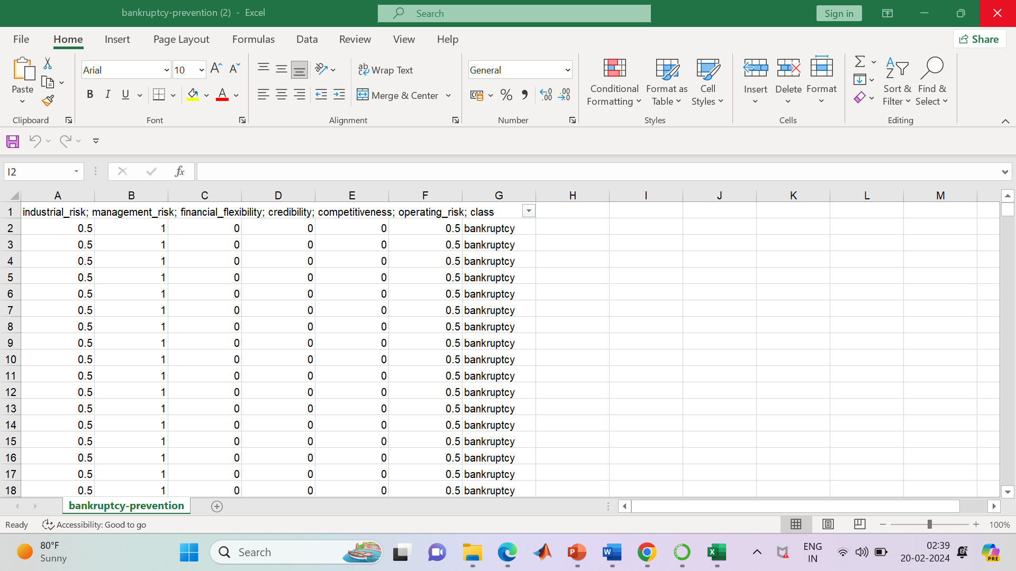
Dataset

Slide 8
EDA
03
• Exploratory data analysis is one of the basic and essential steps of a data science project.
• In our project we have drawn some insights in the EDA process

Slide 9
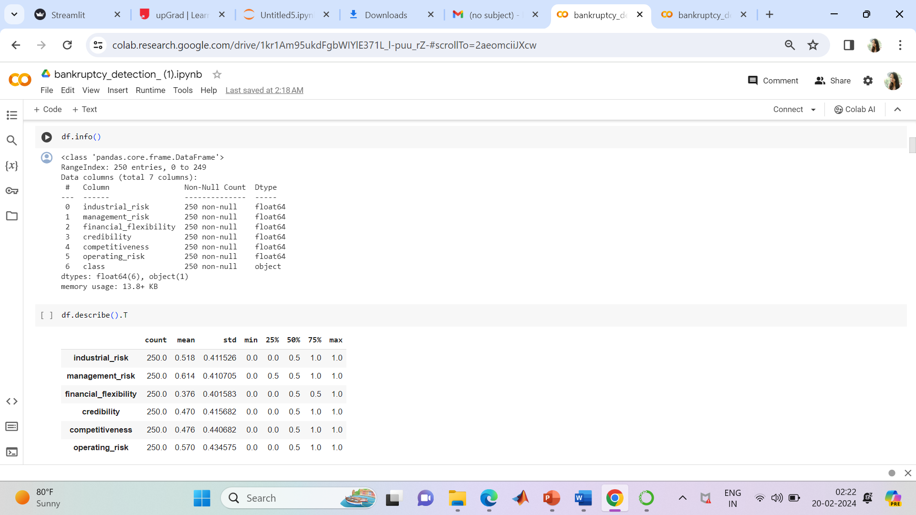

Slide 10
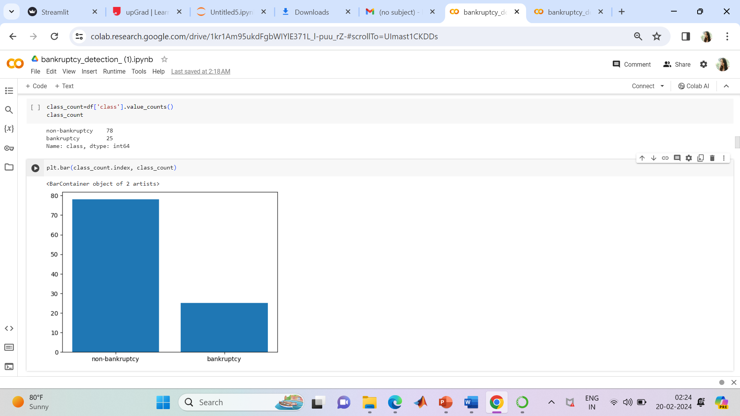
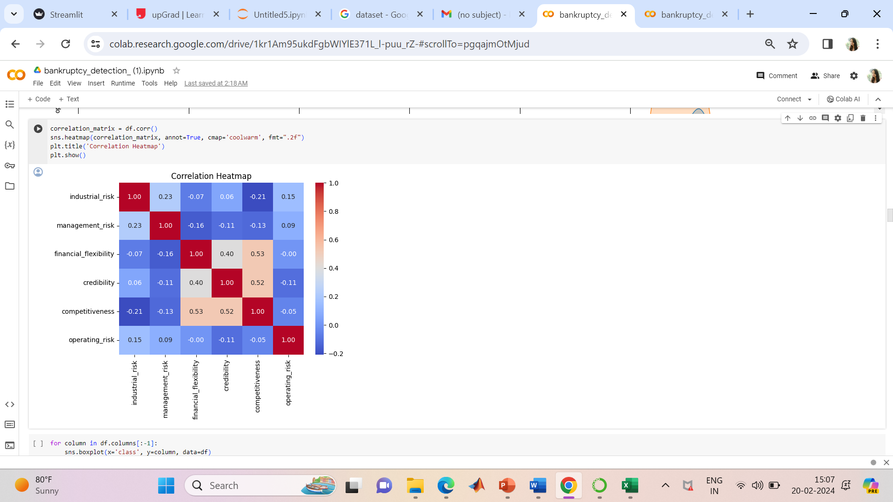

Slide 11
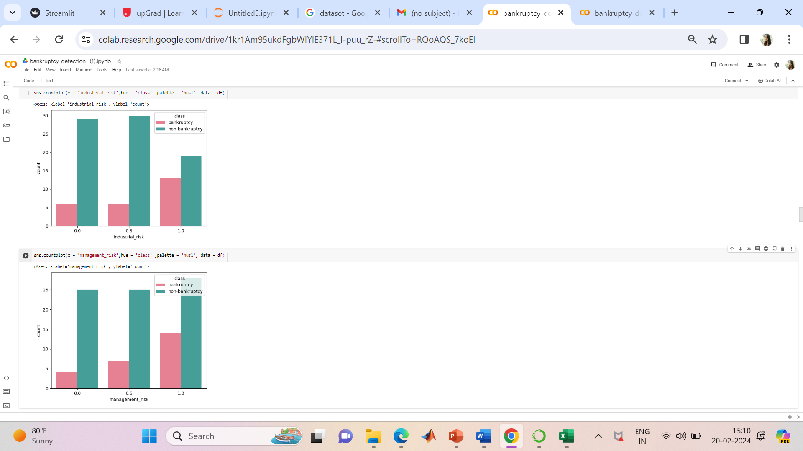
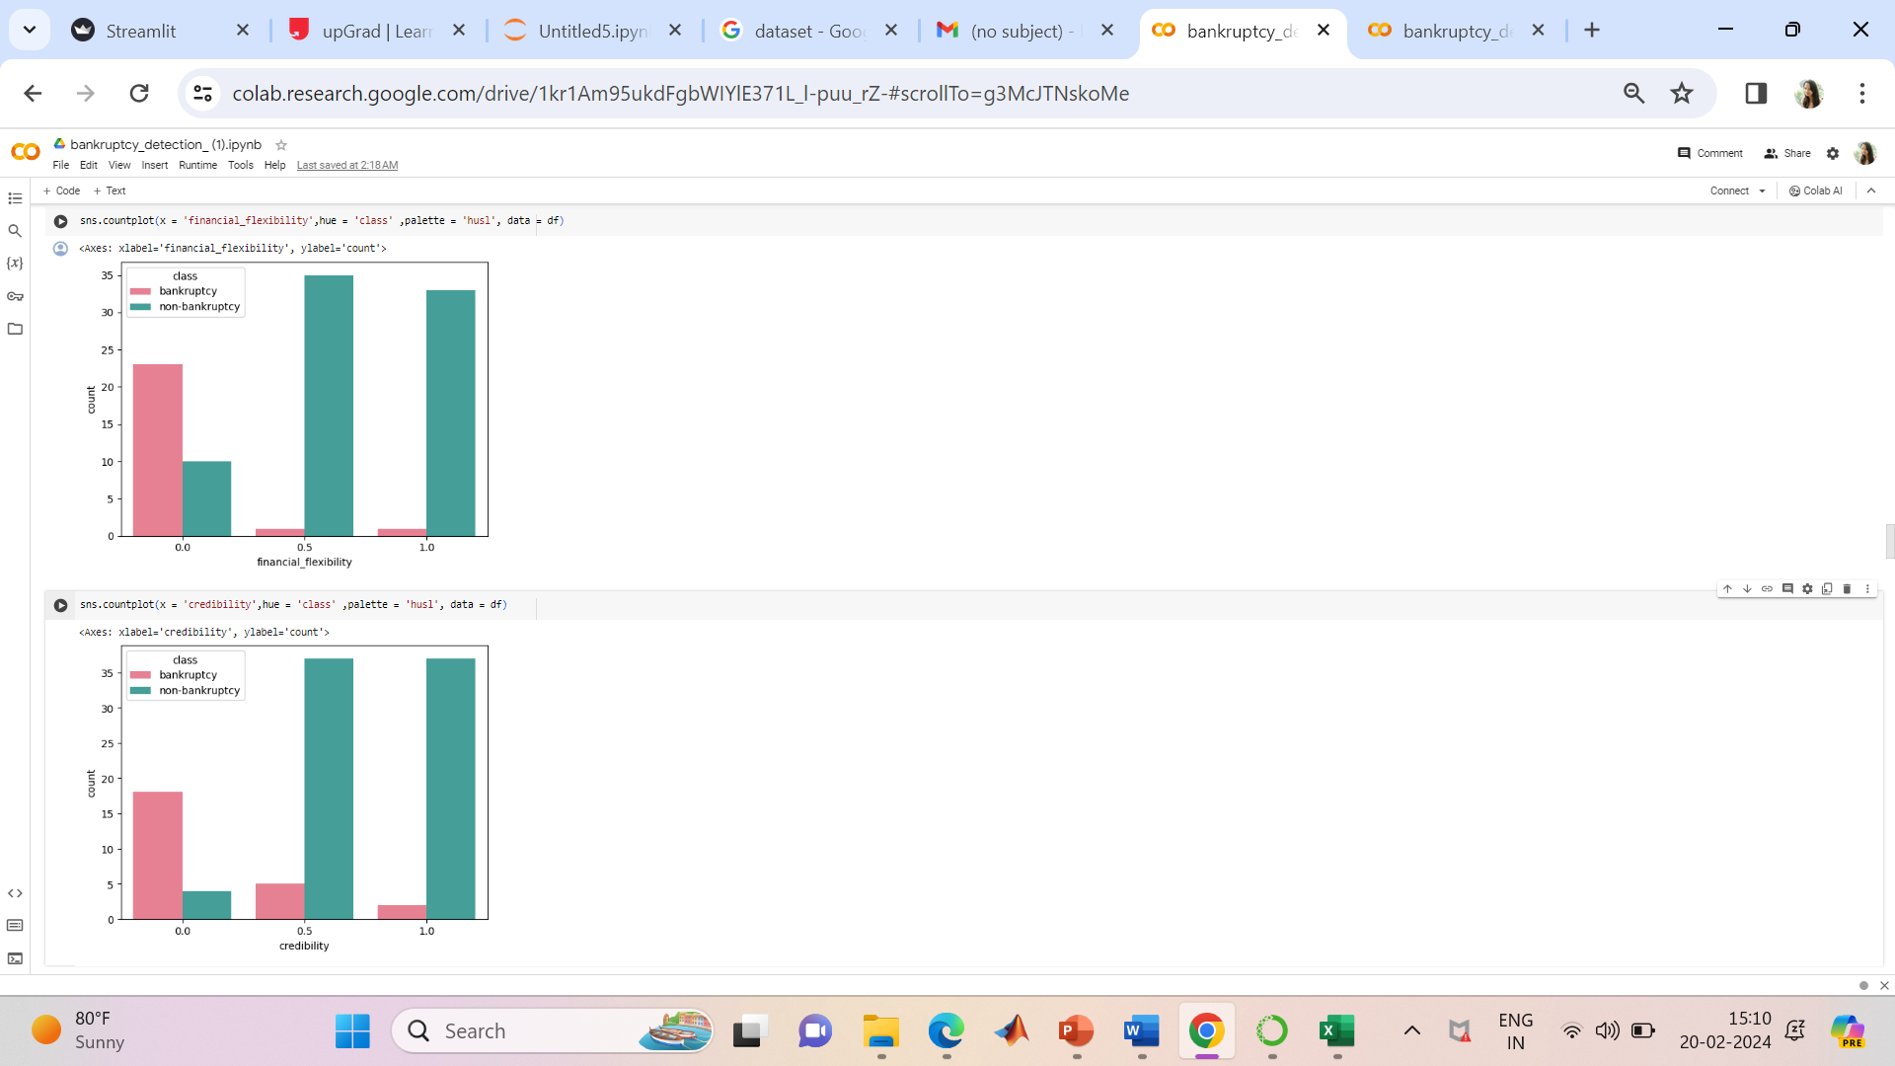
with this we conclude that, if the INDUSTIRIAL_RISK, MANAGEMENT_RISK==1.0 AND FINANCIAL , CREDIBILITY AND COMPITITIVE_RISK ==0 AND OPERATIONAL_RISK==1 , this results the more chance of the bankruptcy....

Slide 12
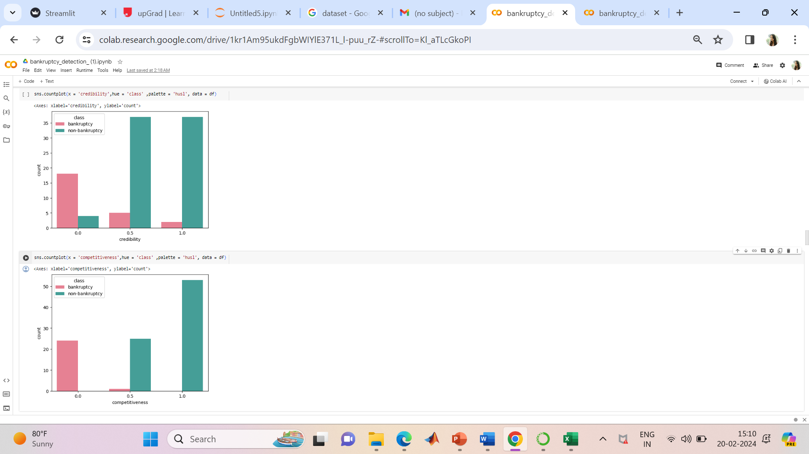
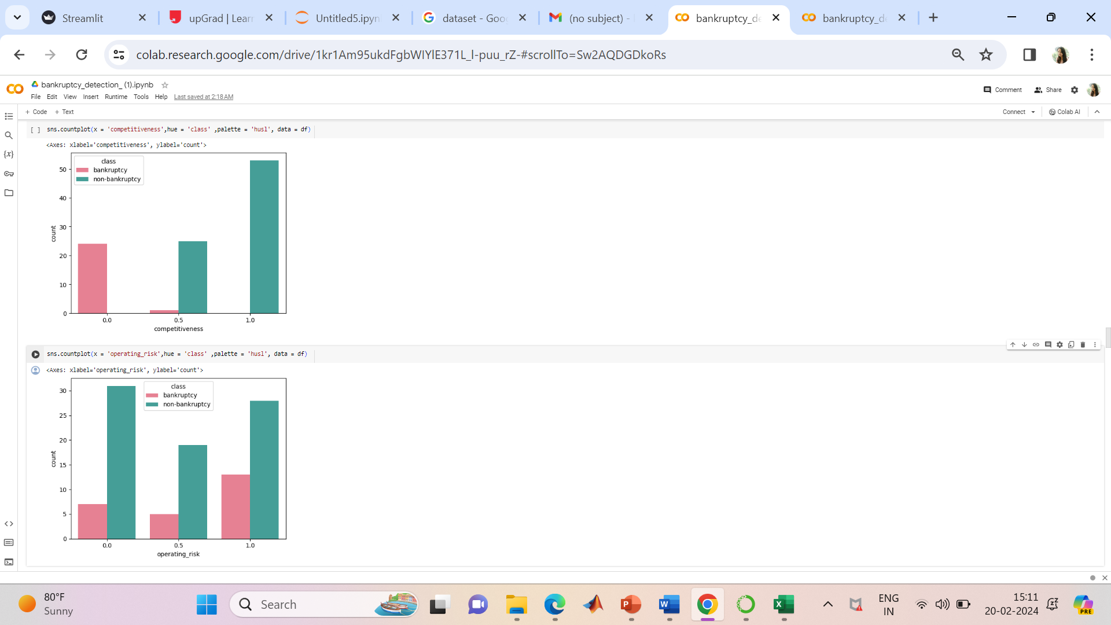
with this we conclude that, if the INDUSTIRIAL_RISK, MANAGEMENT_RISK==1.0 AND FINANCIAL , CREDIBILITY AND COMPITITIVE_RISK ==0 AND OPERATIONAL_RISK==1 , this results the more chance of the bankruptcy....

Slide 13

Bankruptcy Or Non-bankruptcy

Slide 14
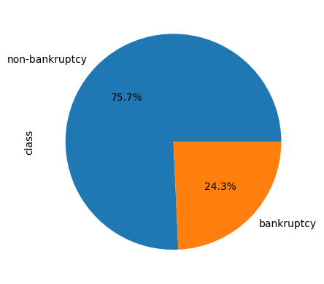
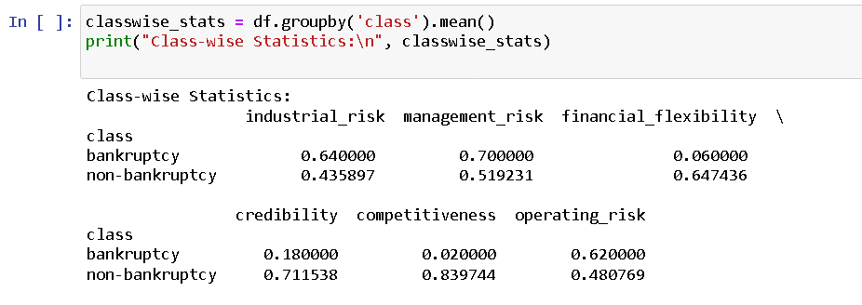

Slide 15
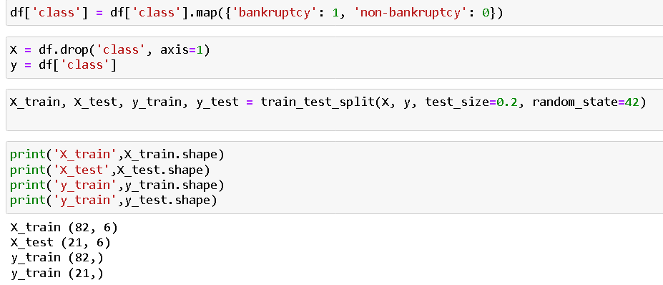
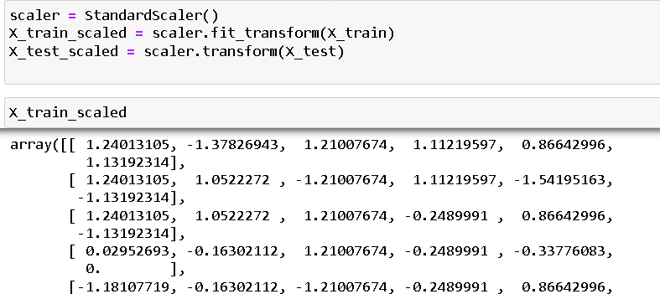
Traning and Testing data

Slide 16
MODEL BUILDING
04
We train a classification model on your training data. start with a simple model like Logistic Regression, and then try more complex models like Random Forest or Gradient Boosting.

Slide 17
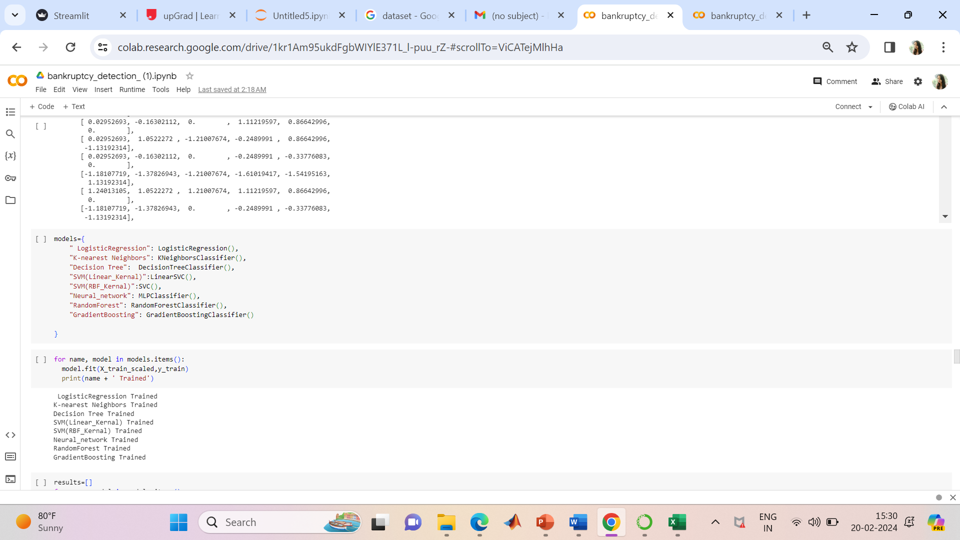
Models

Slide 18
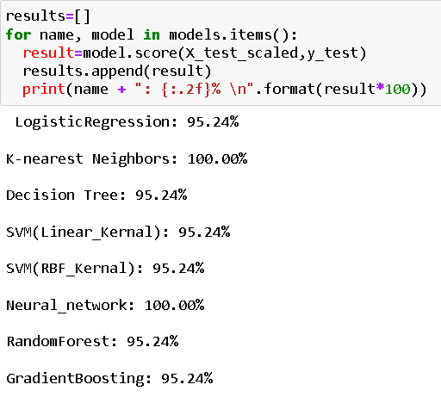
Model Accuracy

Slide 19
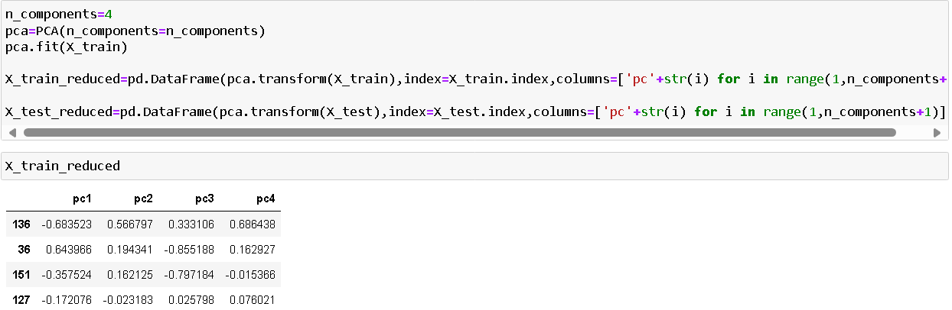
PCA METHOD

Slide 20

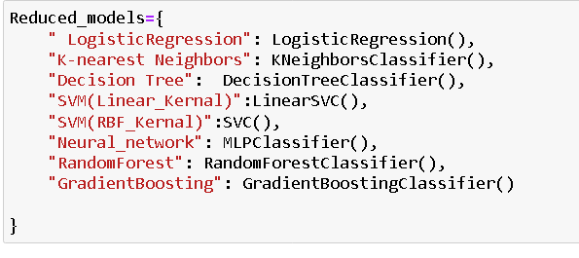
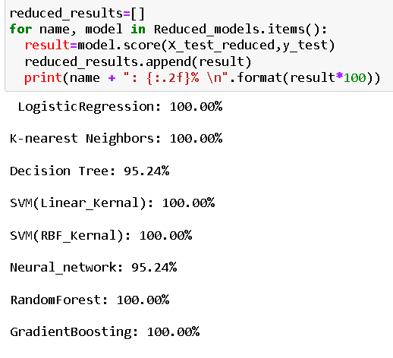

Slide 21
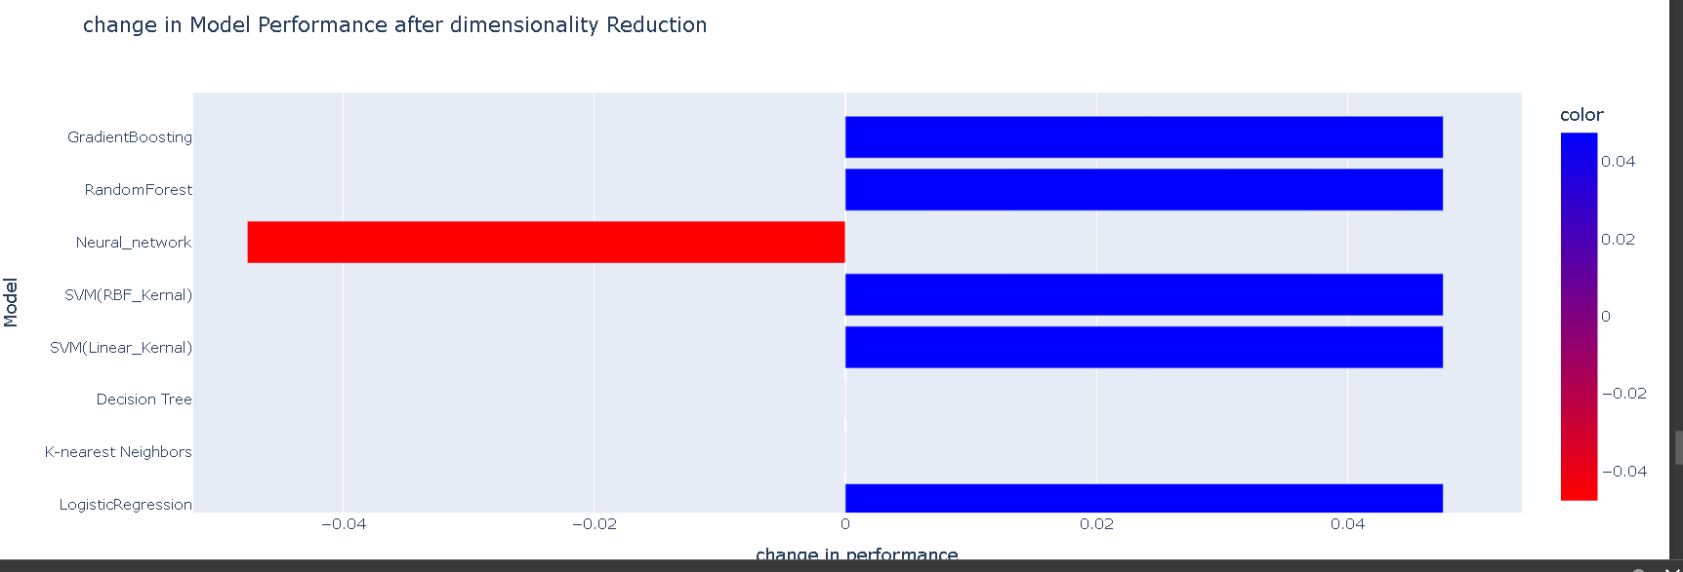
change in Model Performance after dimensionality Reduction

Slide 22
DEPLOYMENT
05
In our model we use Logistic Regression for Deployment.
Deploying a logistic regression model involves several steps, including training the model, saving it, and then loading it in the deployment environment to make predictions.

Slide 23
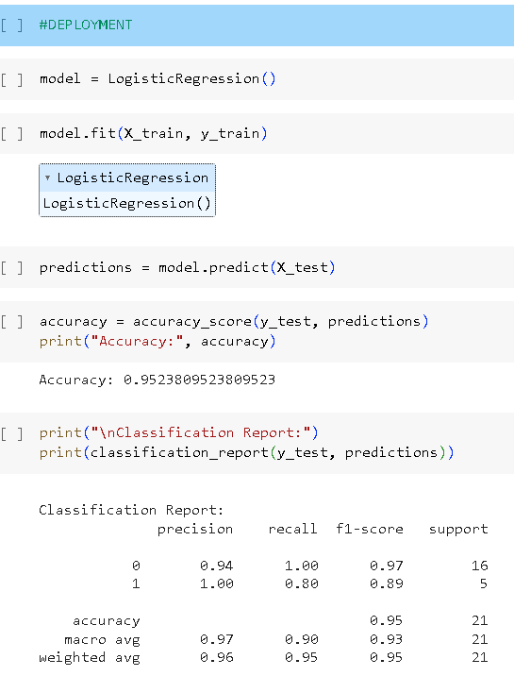
Logistic Regression

Slide 24
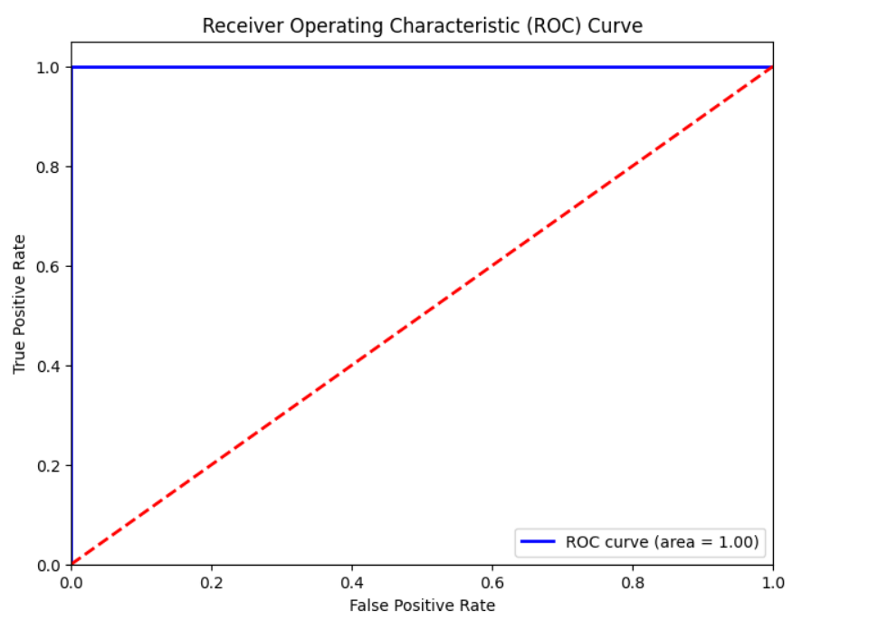
ROC Curve

Slide 25
RESULTS
06
https://bankruptcy-ccugk9i5jxr5tpwaztzxpe.streamlit.app/

Slide 26


Slide 27


Slide 28
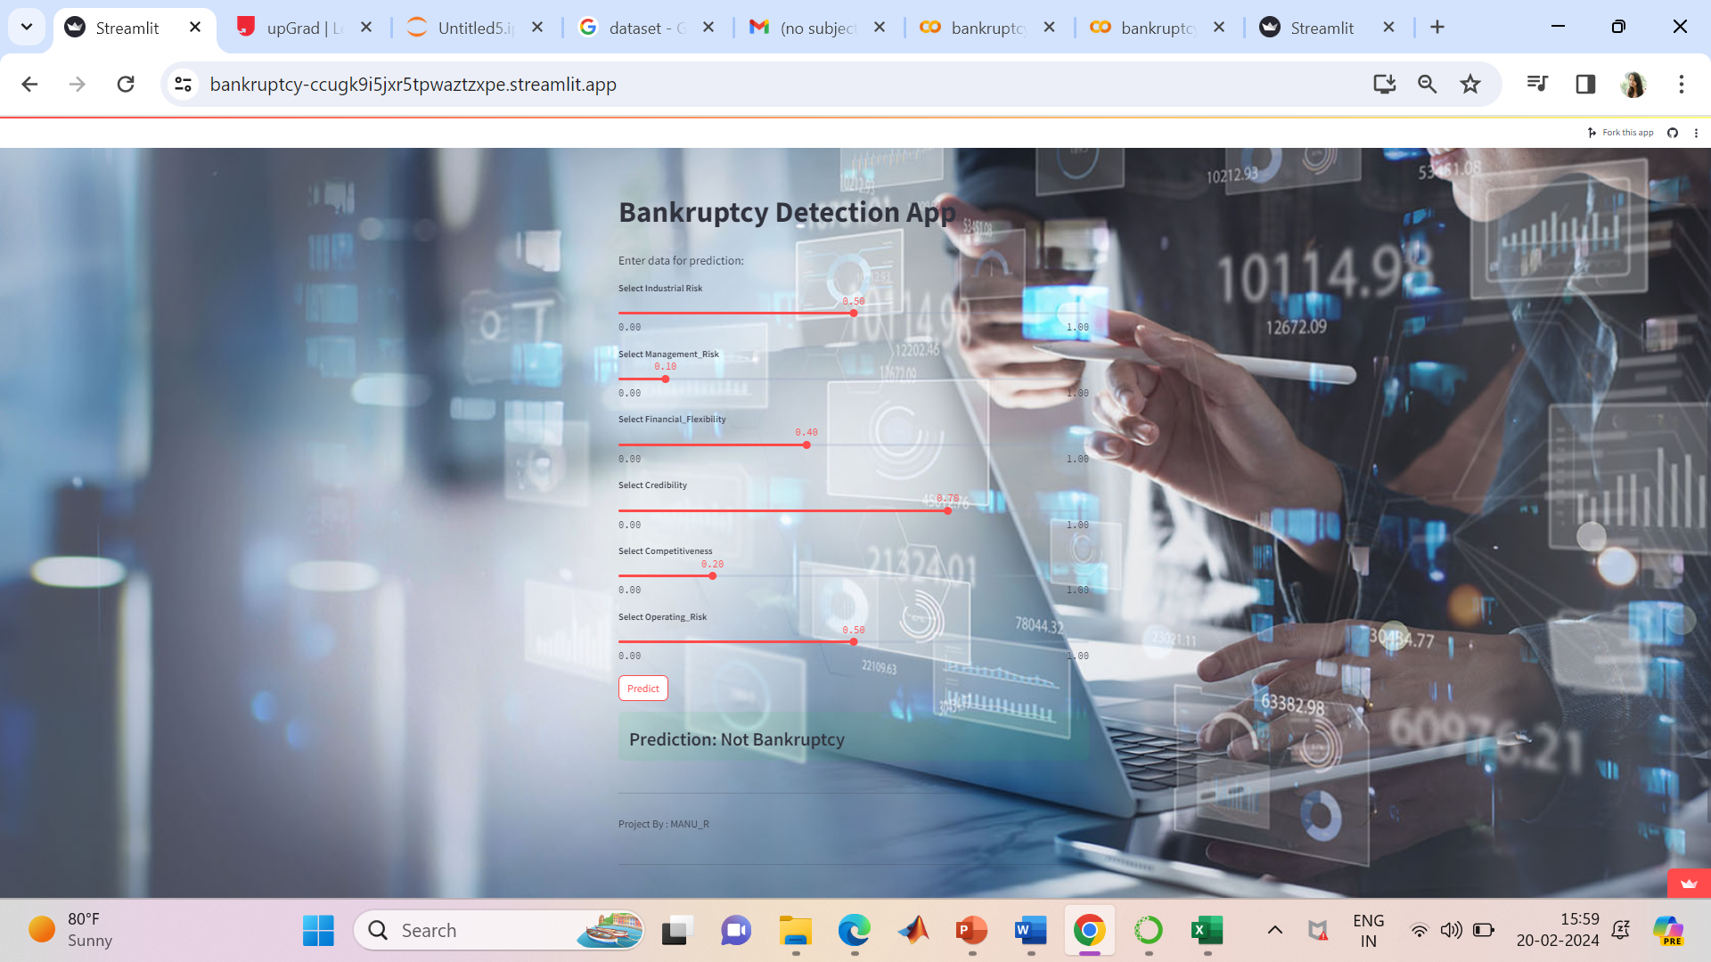


Slide 29
OBSTACLES
Issues faced during the global deployment.
Selecting the right model.

Slide 30
THANK YOU

